Slide 1
Hiring Process Analytics
Name: Prince Kumar
Email : prince22495@gmail.com

Slide 2
Content
Introduction
Project Description
Approach
Tool used
Structure of Table
Insights and Results
Conclusion

Slide 3
Introduction
The hiring process is a vital and critical function for companies.
Multinational corporations (MNCs) gather valuable insights about hiring trends during this process.
Important trends to analyze include the number of rejections, interviews, types of jobs, and vacancies.
Companies need to analyze these trends before hiring freshers or any other individuals.
This analysis also creates an opportunity for a Data Analyst job.

Slide 4
Project Description
Objective: Analyze hiring trends, draw insights, and provide a detailed report.
Responsibilities:
Review data records of previous hirings.
Apply statistical analysis and Excel formulas.
Compile a detailed report and answer specific questions.
Dataset: Company-specific dataset on job hirings.
Tasks:
Data Review: Thoroughly examine the records.
Statistical Analysis: Identify trends and calculate metrics.
Report Preparation: Summarize analysis, provide insights, and address questions.
Questions to be answered
How many males and females are Hired ?
What is the average salary offered in this company ?
Draw the class intervals for salary in the company ?
Draw Pie Chart / Bar Graph ( or any other graph ) to show proportion of people working different department ?
Represent different post tiers using chart/graph?

Slide 5
Approach
Understanding data columns and data
Checking for missing data
Clubbing columns with multiple categories
Checking for outliers
Removing outliers
Drawing Data Summary
Firstly, I would clean the dataset to prepare it for analysis. This involves eliminating the outliers and rows having empty or blank cells. Then, I would proceed towards analyzing and answering questions with visualizations wherever possible.

Slide 6

Tech-Stack Used
Microsoft Excel
For analyzing and visualizing data.

Slide 7
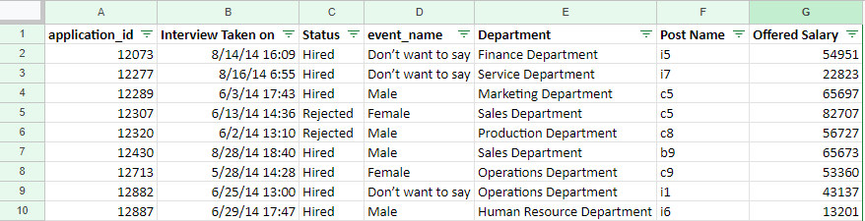
Structure of Dataset
The Hiring dataset consists of following Columns:
application_id
Interview Taken on
Status
event_name
Department
Post name
Offered Salary

Slide 8
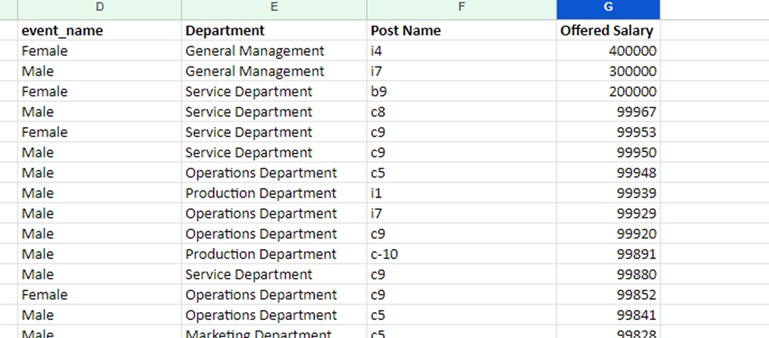
Cleaning the dataset
3 Outliers from “Offered Salary” column were removed.

Slide 9
1 row was deleted because of 1 blank cell was found in the “Post name” column.
1 row was deleted from the dataset because of 1 blank cell in the “Offered Salary” column.

Slide 10
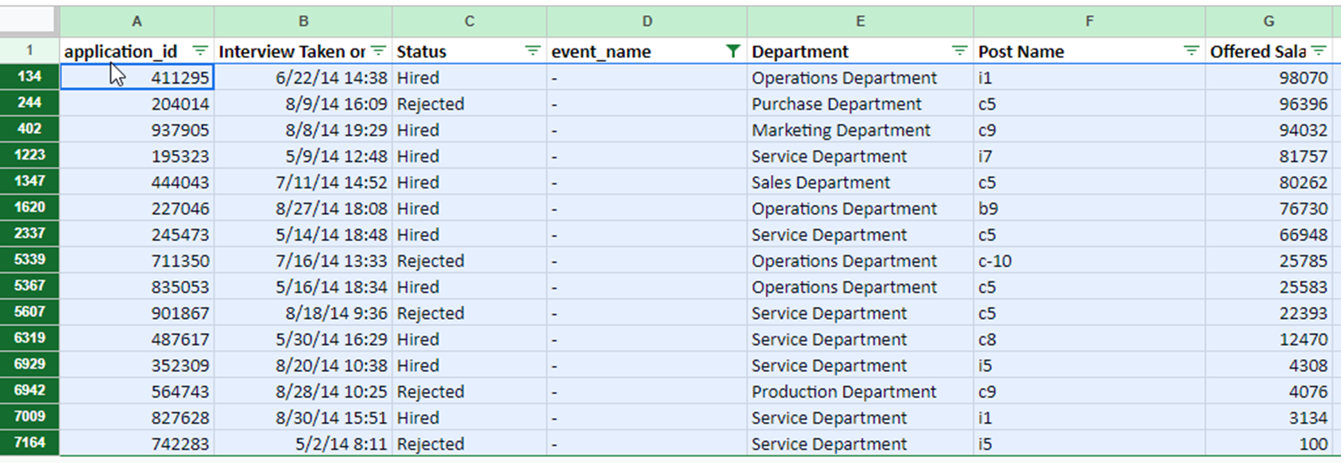
15 rows were deleted from the dataset because of 15 blank cells in the “event_name” column.

Slide 11
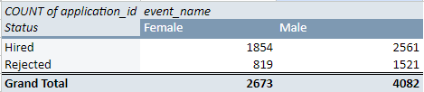
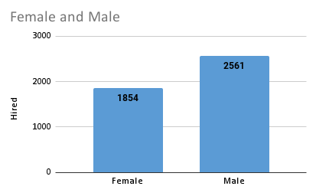
Hiring
Process of in taking of people into an organization for different kinds of positions.
Task: How many males and females are Hired ?
Ans. 2561 males and 1854 females are hired.
Formula used to get the count of hired males and females:
=COUNTIFS(D2:D7149,"Male",C2:C7149,"Hired")
=COUNTIFS(D2:D7149,"Female",C2:C7149,"Hired")
Column chart is used for visualization.

Slide 12

Average Salary:
Task: What is the average salary offered in this company ?
Ans. 49881.14312 is the average salary offered in the company.
Formula used for calculating average salary offered in the company:
=AVERAGE(G2:G7149)
**For calculating the average salary offered both hired and rejected employees are considered.

Slide 13
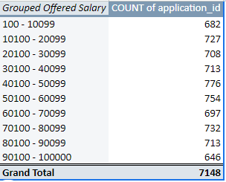
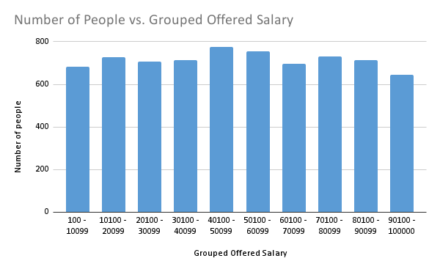
Class Intervals:
Task: Draw the class intervals for salary in the company ?
Created a Pivot table with “Offered Salary” in Rows and Grouped “Offered salary” (starting with 100, by 10000 as interval in each class). “application_id” in Values, summarized by COUNT.
Created a column chart from pivot table to visualize class data.

Slide 14
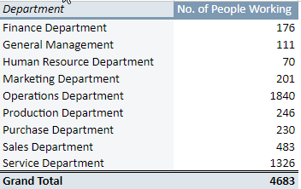
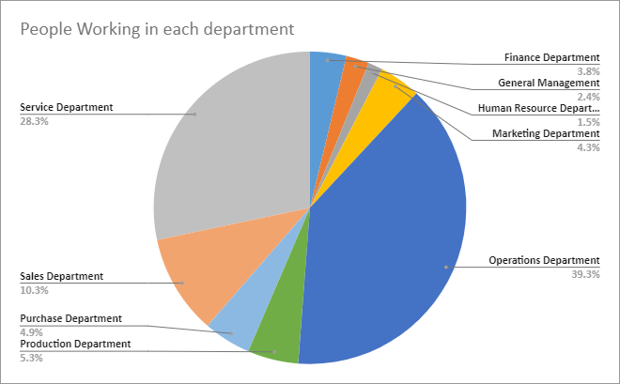
Proportion of people working in different Departments:
Task: Draw Pie Chart / Bar Graph ( or any other graph ) to show proportion of people working in different department ?
First, created a pivot table with “Department” in Rows & “application_id” in Values. Also, “status” in Filters with check-mark only on “hired”.
(*Only ‘hired’ people are consider here.)
Then, created a pie chart using pivot table to visualize the data.

Slide 15
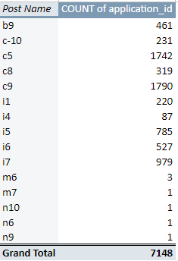
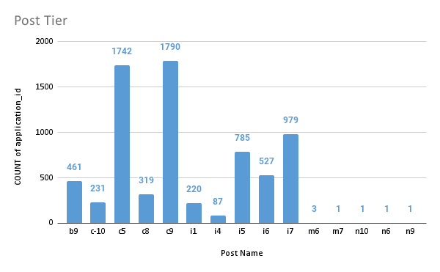
Post Tiers
Task: Represent different post tiers using chart/graph?
First, create a pivot table with “Post name” in Rows and COUNT of “application_id” in Values.
Then, created a column chart from the pivot table for visualizing post tiers and their respective Application counts.

Slide 16
Summary of Results:
2561 males and 1854 females are hired.
49881.14312 is the average salary offered in the company.
Maximum people i.e. 776 belong to the 40K - 50K offered salary range.
Maximum employees work in the “Operation Department” followed by “Service Department”. Lowest number of employees are working in Human Resource Department.
Most of the employees are working in the c9 post tier.

Slide 17
File Links
Project link: Click Here!
Working File link: Click Here!

Slide 18
Thank You! ^_^

